Slide 1
Multi Threading in Java
Basic to Advance level

Slide 2
Day 1

Slide 3
1. Introduction to Threads
What is thread ?
What are threads?
Why use threads?
Thread states (new, runnable, blocked, waiting, timed waiting, terminated)

Slide 4
2. Creating and Running Threads
Extending the Thread class
Implementing the Runnable interface
Starting a thread
Naming threads
Thread priorities

Slide 5
3. Synchronization and Thread Safety
Introduction to thread synchronization
Shared resources and data races
Critical sections and mutual exclusion
Synchronized blocks and methods
Thread-safe collections and classes

Slide 6
4. Thread Communication and Coordination
Thread communication methods (wait, notify, notifyAll)
The Producer-Consumer problem
Inter-thread communication using shared objects
Thread signaling and signaling patterns
Thread interruption and interruption handling
Thread local variables

Slide 7
5. Thread Pools and Executors
Introduction to thread pools
The Executor framework
Executors, ExecutorService, and ThreadPoolExecutor
Submitting tasks to thread pools
Controlling thread pool size and behavior
Scheduled thread pools
Callable and Future for retrieving results

Slide 8
6. Thread Synchronization Tools
Semaphores and mutexes
CountDownLatch and CyclicBarrier
Phaser and Exchanger
ReadWriteLock
Condition objects
Atomic variables and classes

Slide 9
7. Parallel and Asynchronous Programming
Parallel streams in Java 8+
CompletableFuture for asynchronous programming
Combining multiple CompletableFutures
Handling exceptions in CompletableFutures
CompletableFuture timeouts and cancellation

Slide 10
8. Thread Safety Techniques
Immutable objects
Thread-local storage
Concurrency control using locks
Atomic variables and classes
Concurrent collections (ConcurrentHashMap, ConcurrentLinkedQueue, etc.)
Software Transactional Memory (STM)

Slide 11
Day 2

Slide 12
1. Introduction to Threads
What is thread ?
What are threads?
Why use threads?
Thread states (new, runnable, blocked, waiting, timed waiting, terminated)

Slide 13
What is thread ?
It is a independent path of execution with in a same program.
What are threads?
Threads are independent sequences of instructions that can be executed concurrently within a program, allowing different tasks to be performed simultaneously

Slide 14
Why use threads?
Using threads can bring several benefits to your application, including:
Responsiveness: Threads allow the program to remain responsive even when performing time-consuming tasks.
By running these tasks in separate threads, the main thread can continue executing other operations or respond to user input.
Concurrency: Threads enable multiple tasks to be executed concurrently, improving the overall throughput and efficiency of the application.

Slide 15
Asynchronous operations: Threads can be used to perform background tasks asynchronously, allowing the main thread to continue with other operations without waiting for the task to complete.
Parallelism: By dividing a large task into smaller subtasks that can be executed concurrently, threads enable parallel processing, which can significantly speed up the execution time.

Slide 16
Thread States :
Threads can be in one of the following states:
New: The thread has been created but has not yet started.
Runnable: The thread is eligible to run, and it may be executing or waiting for its turn to execute.
Blocked: The thread is waiting for a monitor lock to enter a synchronized block/method.

Slide 17
Waiting: The thread is in a waiting state, often waiting for another thread to perform a specific action.
Timed Waiting: Similar to the waiting state, but with a specified time duration for waiting.
Terminated: The thread has completed its task or has been terminated.

Slide 18
Day 3

Slide 19
2. Creating and Running Threads
Extending the Thread class
Implementing the Runnable interface
Starting a thread
Naming threads
Thread priorities

Slide 20
Extending the Thread class:
Create a new class that extends the Thread class.
Override the run() method in your class. This method contains the code that will be executed when the thread starts.
Instantiate an object of your custom thread class.
Call the start() method on the thread object to begin its execution. The start() method internally calls the run() method.

Slide 21
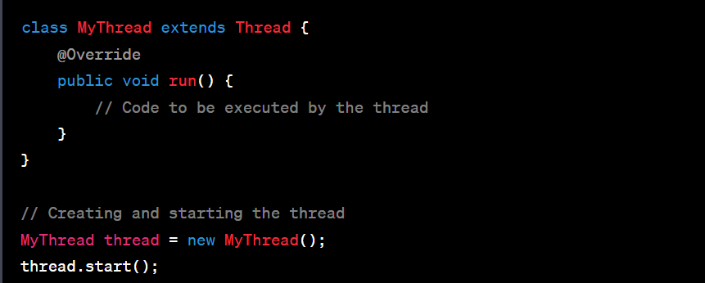

Slide 22
Implementing the Runnable interface:
Create a class that implements the Runnable interface.
Implement the run() method in your class, which contains the code to be executed by the thread.
Instantiate an object of your class.
Create a Thread object, passing the instance of your class as a parameter to its constructor.
Call the start() method on the Thread object to start the execution of the thread.

Slide 23
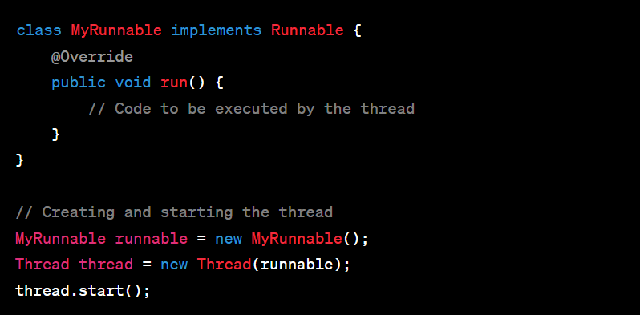

Slide 24
Lambda Expression (Java 8+):
Use lambda expressions to create an anonymous implementation of the Runnable interface.
Pass the lambda expression to the Thread constructor.
Call the start() method on the Thread object to start the thread.

Slide 25
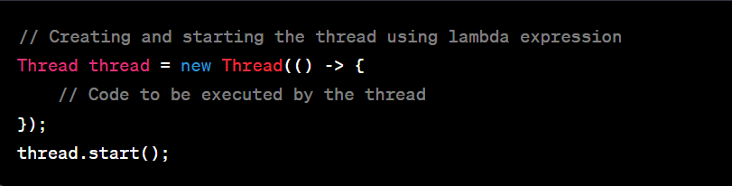

Slide 26
Thread Name:
You can assign a name to a thread by calling the setName() method or by passing the name as a parameter to the Thread constructor.
The name can be retrieved using the getName() method.

Slide 27
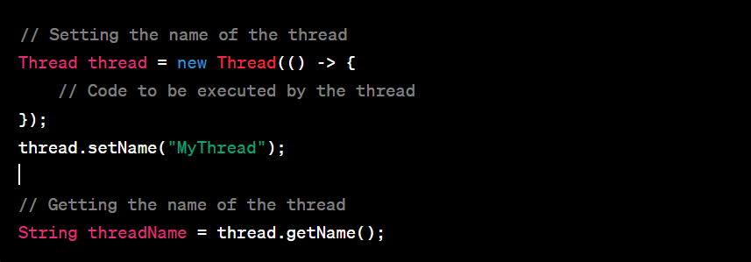

Slide 28
Remember, when a thread's run() method is invoked, it runs independently alongside other threads. The order of execution and context switching between threads is managed by the underlying operating system and the JVM.
Creating and running threads is the foundation of multi-threaded programming. Once you understand this concept, you can explore synchronization, communication between threads, and more advanced topics to build robust and concurrent applications.

Slide 29
Thread priorities
Thread Priority Levels:
Thread priorities in Java are represented by integer values.
The range of thread priorities is typically from 1 (lowest) to 10 (highest).
The Thread class provides constants for priority levels: MIN_PRIORITY (1), NORM_PRIORITY (5), and MAX_PRIORITY (10).
Setting Thread Priority:
You can set the priority of a thread using the setPriority() method, which accepts an integer value representing the desired priority level.
The default priority of a thread is NORM_PRIORITY (5).

Slide 30
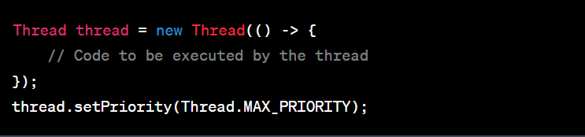

Slide 31
Day 4

Slide 32
3. Synchronization and Thread Safety
Introduction to thread synchronization
Shared resources and data races
Critical sections and mutual exclusion
Synchronized blocks and methods
Thread-safe collections and classes

Slide 33
What is Synchronization in java and why we need it ?
Class SbiBank
Saddam Account (Object)
Debit card
(withdraw)
UPI
(Deposit)

Slide 34
Saddam account have total balance = 7000
Saddam withdraw = 3000
--------------------
After withdraw remaining balance = 4000
Saddam withdraw 3000 balance at same time Someone deposit 12000 in Saddam account.
Now Saddam account Total Balance is 12000 + 4000 = 16000.

Slide 35
Important Note :
Both the transactions are happening at same time at milli second or nano second difference.
If one performance is happening the another performance is waiting until to finish the first performance. This is called Synchronization.

Slide 36
Without Synchronization
Saddam account total balance = 7000
Saddam withdraw = 3000
After withdraw remaining balance = 4000
Someone deposit 10000 to Saddam account at same time
Actual Saddam Total Amount = 14000
Saddam will enquire the balance
If it will show 4000 Saddam loss 10000
If it will show 10000 Saddam loss 4000

Slide 37
Java Programming
Class SbiBank
Saddam Account (Object)
ATM
Thread 1
Google pay Thread 2
Debit card
(withdraw)
UPI
(Deposit)
Withdraw() - m1
Deposit() - m2

Slide 38
Saddam Account object
Thread 1 synchronized m1 (Object lock)
Thread 2 synchronized m2 (waiting)

Slide 39
Shared resources and data races
Shared resources are data or objects that multiple threads can access and modify.
Examples of shared resources include variables, data structures, files, or databases.
When multiple threads have access to the same shared resource, it means they can read from or write to it.
data races occur when those threads access and modify the shared resource simultaneously without proper coordination, leading to unpredictable and incorrect results.

Slide 40
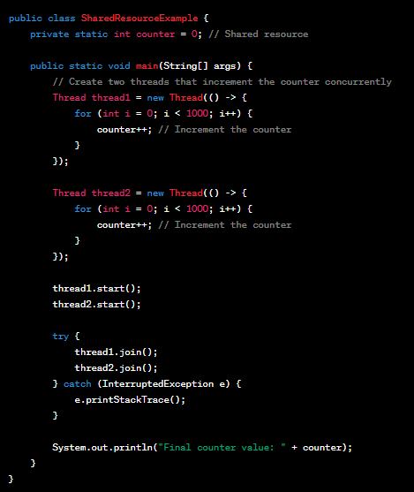

Slide 41
To fix this data race, we can introduce synchronization mechanisms, such as using the synchronized keyword or locks, to ensure that only one thread can access and modify the shared resource at a time.
This prevents data races and ensures consistent and predictable results.

Slide 42
Critical sections and mutual exclusion
Critical Sections: Specific parts of the code where shared resources are accessed and modified.
Mutual Exclusion: Ensures only one thread can access a critical section at a time, preventing conflicts and maintaining data integrity.

Slide 43
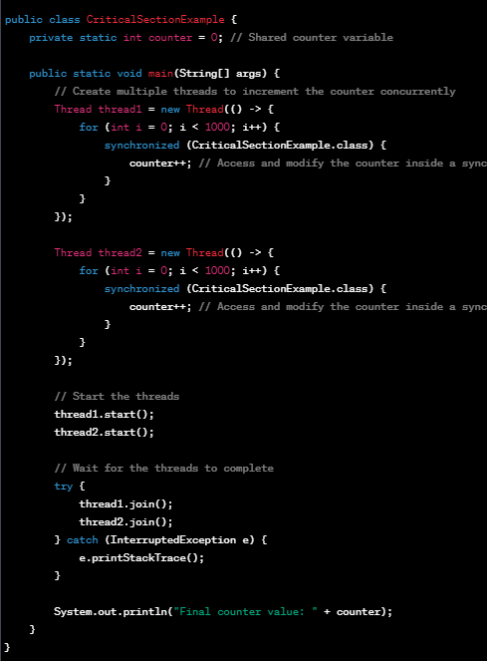

Slide 44
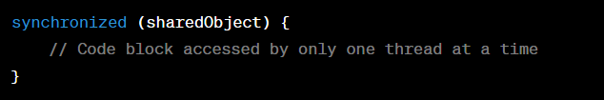
Synchronized blocks and methods
Synchronized Blocks: Allows a specific section of code to be accessed by only one thread at a time, ensuring mutual exclusion. For example:

Slide 45
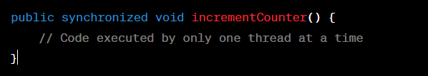
Synchronized Methods: Ensures that only one thread can execute the entire method at a time, providing mutual exclusion. For example:
In both examples, the synchronized keyword ensures that only one thread can access the synchronized block or method at any given time, preventing conflicts and maintaining data integrity.

Slide 46
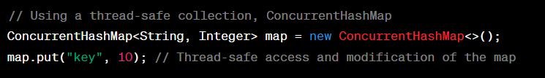
Thread-safe collections and classes
These are data structures or classes that are designed to be used by multiple threads concurrently without requiring additional synchronization.
They provide built-in mechanisms to ensure safe access and modification of data in a multi-threaded environment. For example:

Slide 47
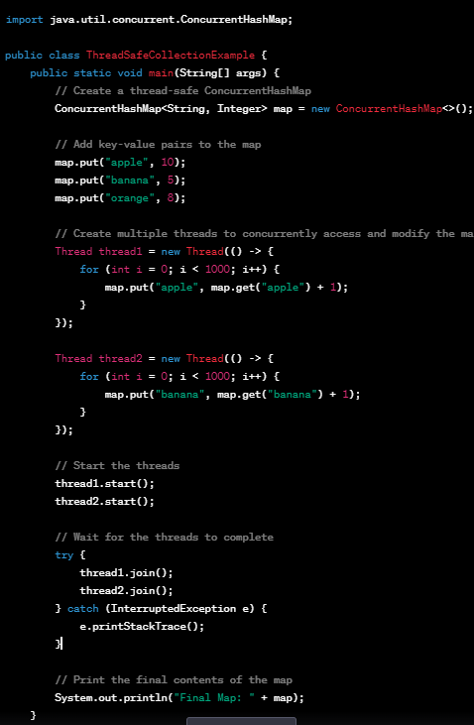

Slide 48
Day 5

Slide 49
4. Thread Communication and Coordination
Thread communication methods (wait, notify, notifyAll)
The Producer-Consumer problem
Inter-thread communication using shared objects
Thread signaling and signaling patterns
Thread interruption and interruption handling
Thread local variables

Slide 50
Thread communication methods (wait, notify, notifyAll)
Two threads can communicate with each other by using wait(), notify() and notifyAll() methods.
The wait() method causes the current thread to wait until another thread invokes the notify() or notifyAll() methods for that object.
The notify() method wakes up a single thread that is waiting on that object's monitor.
The notifyAll() method wakes up all threads that are waiting on that object's monitor.

Slide 51
Wait()
Thread 1
Thread 2
Notify(), NotifyAll()

Slide 52
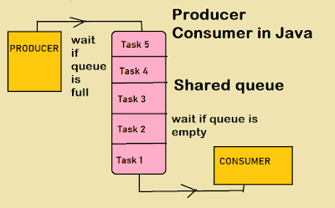
The Producer-Consumer problem

Slide 53
Producer: A thread responsible for producing or generating data/items and adding them to a shared buffer.
Consumer: A thread responsible for consuming or processing data/items from the shared buffer.

Slide 54
Inter-thread communication using shared objects
Inter-thread communication using shared objects allows threads to coordinate and exchange data through a common object.
It typically involves synchronization mechanisms like synchronized blocks, wait(), and notify() methods.

Slide 55
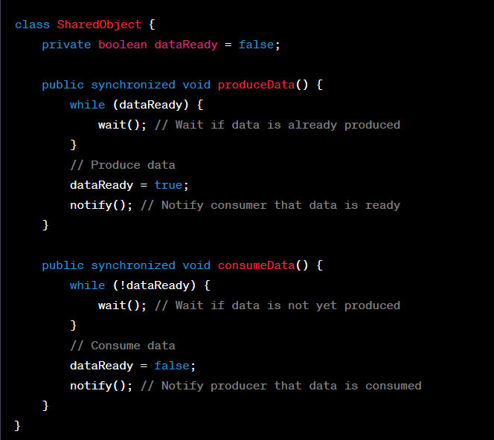

Slide 56
Thread Signaling and Signaling Patterns:
Thread signaling is a mechanism used by threads to communicate and coordinate with each other.
It involves signaling patterns like wait() and notify() (or notifyAll()) methods to wait for signals and wake up other waiting threads when specific conditions are met.
Producer thread signals the consumer thread to consume an item using wait() and notify() methods in Java.

Slide 57
Thread interruption and interruption handling
Thread interruption is a way to signal a thread to stop its execution gracefully.
Interruption handling is the process of checking for interruptions and taking appropriate actions, such as cleaning up resources and terminating the thread, in response to the interruption signal.

Slide 58
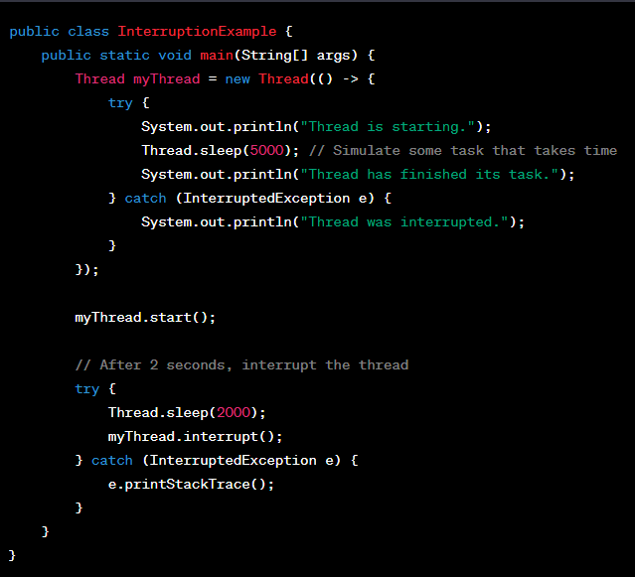

Slide 59
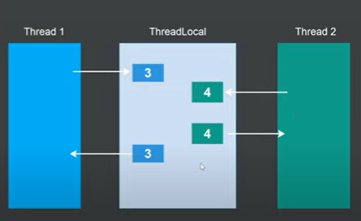
Thread local variables

Slide 60
Thread-local variables are like separate "storage boxes" for each thread.
Imagine you have a group of workers (threads), and each worker has their own personal storage box (thread-local variable)
where they can put their tools (data) without sharing with other workers.

Slide 61
Day 6

Slide 62
5. Thread Pools and Executors
Introduction to thread pools
The Executor framework
Executors, ExecutorService, and ThreadPoolExecutor
Submitting tasks to thread pools
Controlling thread pool size and behavior
Scheduled thread pools
Callable and Future for retrieving results

Slide 63
Introduction to thread pools
Thread pools are a group of pre-initialized worker threads that can be used to efficiently execute multiple tasks concurrently.
They help in managing and reusing threads, reducing the overhead of creating new threads for each task.

Slide 64
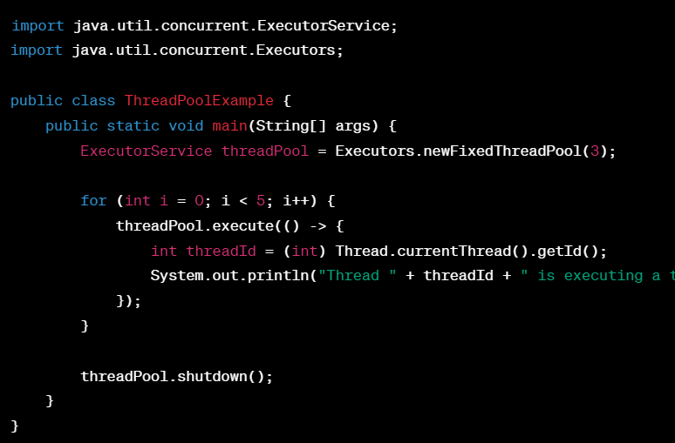

Slide 65
The Executor framework
The Executor framework in Java simplifies concurrent task execution by managing threads and provides a way to execute tasks asynchronously using thread pools.

Slide 66
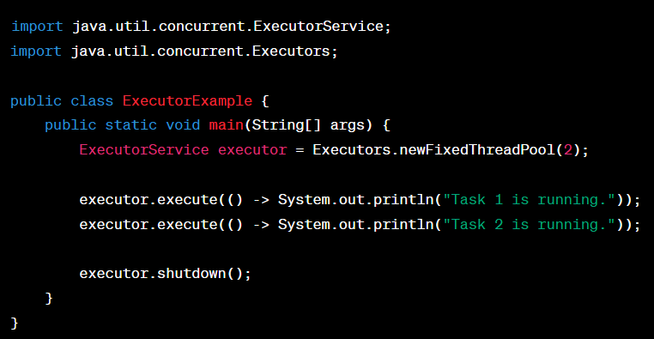

Slide 67
Executors:
The Executors class in Java provides factory methods to create instances of ExecutorService, which is used to manage and execute tasks.
ExecutorService:
ExecutorService is a higher-level interface that extends Executor and provides additional methods to manage asynchronous task execution and handle the result of tasks.
ThreadPoolExecutor:
ThreadPoolExecutor is an implementation of the ExecutorService interface that provides a thread pool to execute tasks concurrently, reusing threads to minimize the overhead of thread creation.

Slide 68
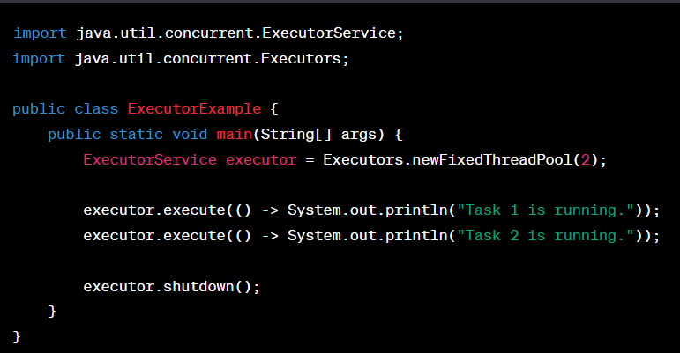

Slide 69
Submitting tasks to thread pools
Submitting tasks to thread pools involves using the execute() or submit() method of the ExecutorService interface to send tasks for concurrent execution by the available threads in the pool.

Slide 70
Controlling Thread Pool Size and Behavior:
You can control the thread pool size and behavior by creating a ThreadPoolExecutor instance directly, providing the desired parameters for core pool size, maximum pool size, and task queuing.

Slide 71
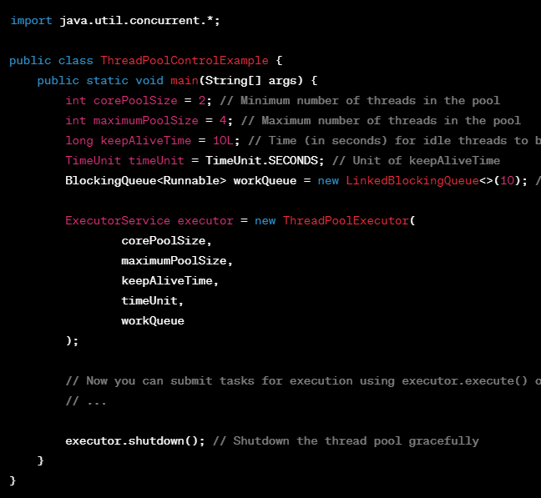

Slide 72
Scheduled Thread Pools:
Scheduled thread pools in Java are used to execute tasks at specific intervals or after a delay. They are suitable for scheduling recurring tasks.

Slide 73
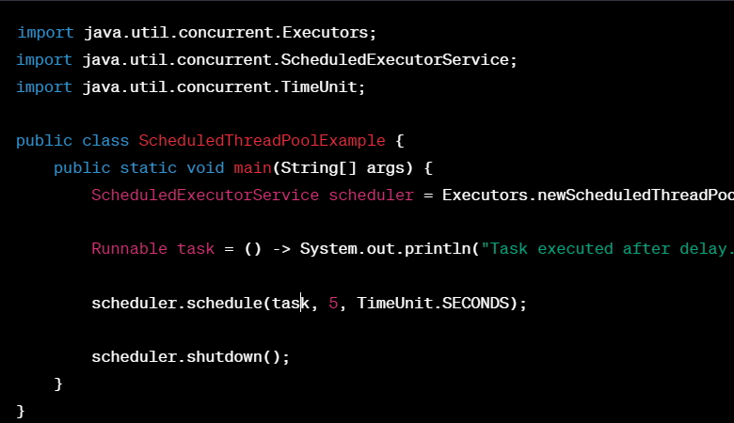

Slide 74
Callable and Future for Retrieving Results:
In Java, Callable is an interface that represents a task that can return a result. Future is an interface used to hold the result of a Callable task until it's ready.

Slide 75
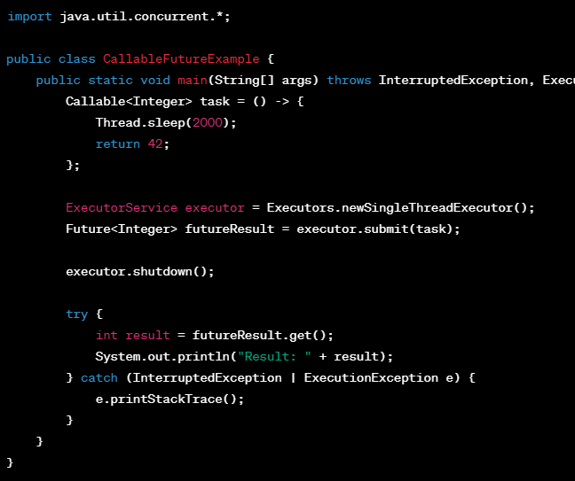

Slide 76
Day 7

Slide 77
6. Thread Synchronization Tools
Semaphores and mutexes
CountDownLatch and CyclicBarrier
Phaser and Exchanger
ReadWriteLock
Condition objects
Atomic variables and classes

Slide 78
Semaphores:
Semaphores are synchronization tools that control access to a limited number of resources.
They allow a specific number of threads to access a shared resource simultaneously.

Slide 79
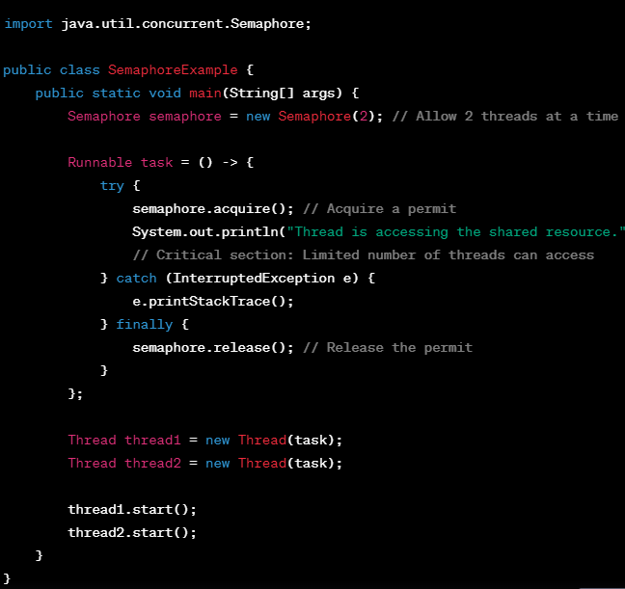

Slide 80
Locks and Mutexes:
Locks and mutexes are synchronization mechanisms that allow only one thread to access a shared resource at a time, ensuring data consistency in multithreaded applications.

Slide 81
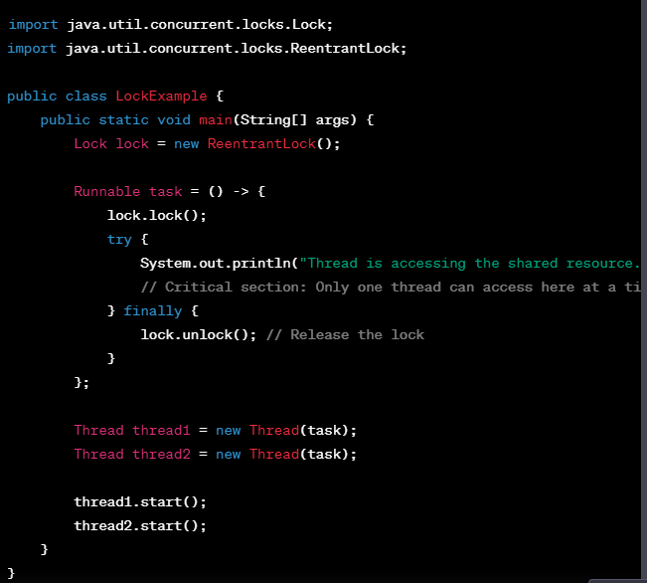

Slide 82
CountDownLatch :
CountDownLatch is a synchronization aid that allows one or more threads to wait until a set of operations being performed in other threads completes.
:

Slide 83
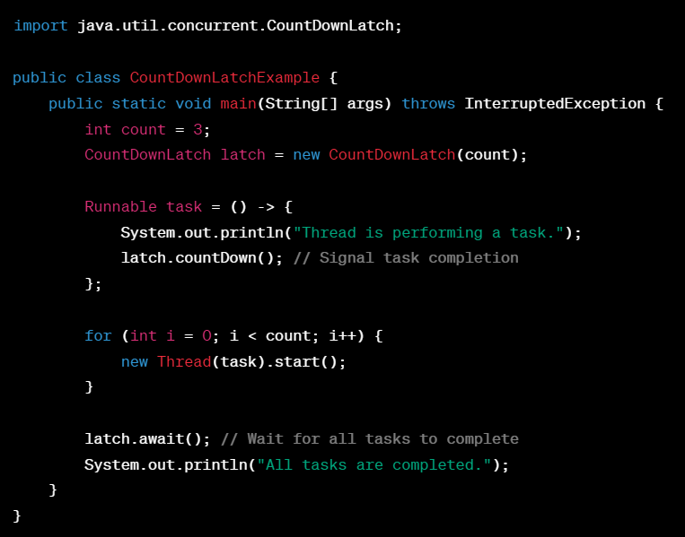

Slide 84
CyclicBarrier:
CyclicBarrier is a synchronization barrier that allows a set of threads to wait for each other to reach a common barrier point before proceeding.
It's often used when threads need to work together in multiple phases.

Slide 85
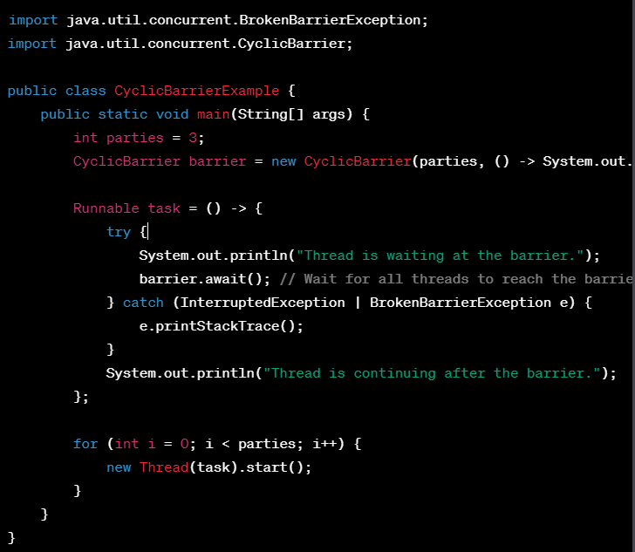

Slide 86
Phaser and Exchanger:
Phaser is a class in Java that provides more advanced synchronization than CountDownLatch or CyclicBarrier.
It allows a set of threads to work in phases, where they synchronize at specific points.

Slide 87
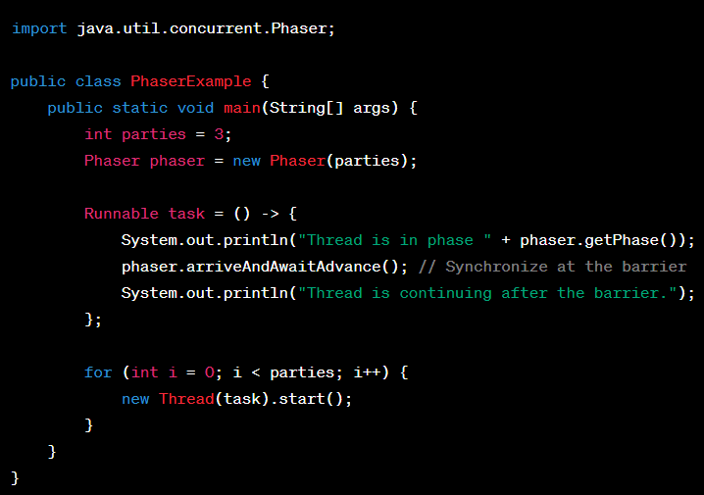

Slide 88
Exchanger :
Exchanger is a class in Java that allows two threads to exchange objects at a synchronization point.

Slide 89
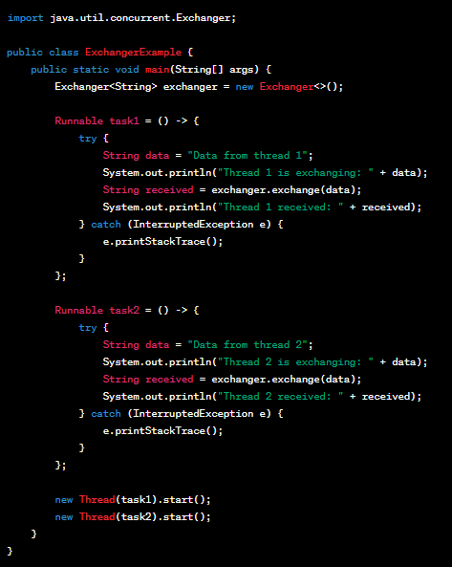

Slide 90
ReadWriteLock:
ReadWriteLock is an interface in Java that provides a way to manage concurrent access to a shared resource where reads can be performed simultaneously by multiple threads, but writes require exclusive access.

Slide 91
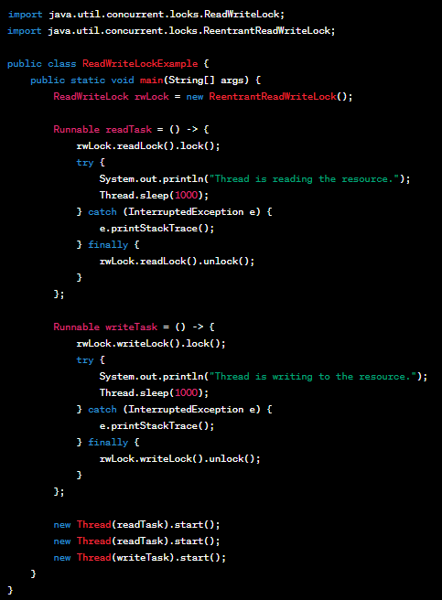

Slide 92
Condition Objects:
Condition is an interface in Java's java.util.concurrent.locks package that provides a way to coordinate the execution of threads based on certain conditions.

Slide 93
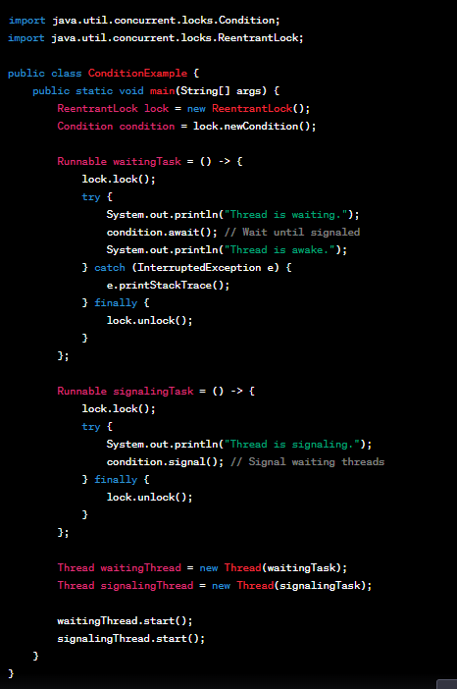

Slide 94
Atomic Variables and Classes:
Atomic variables and classes in Java, found in the java.util.concurrent.atomic package, provide thread-safe operations without the need for explicit locking.
They're used to ensure that certain operations are executed atomically, without interference from other threads.

Slide 95
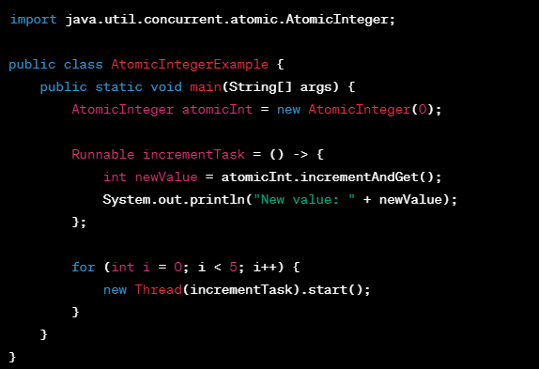

Slide 96
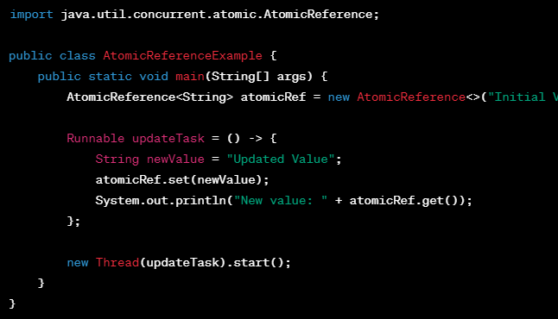
In this example, an AtomicReference is used to safely update a reference to an object.
The set() method atomically updates the reference, ensuring consistency.

Slide 97
Day 8

Slide 98
7. Parallel and Asynchronous Programming
Parallel streams in Java 8+
CompletableFuture for asynchronous programming
Combining multiple CompletableFutures
Handling exceptions in CompletableFutures
CompletableFuture timeouts and cancellation

Slide 99
Parallel streams in Java 8+ :
In Java 8 and later, the Stream API allows you to process collections of data in a more functional and declarative way.
Parallel streams are a feature of the Stream API that enables concurrent processing of data, potentially speeding up operations on large datasets.

Slide 100
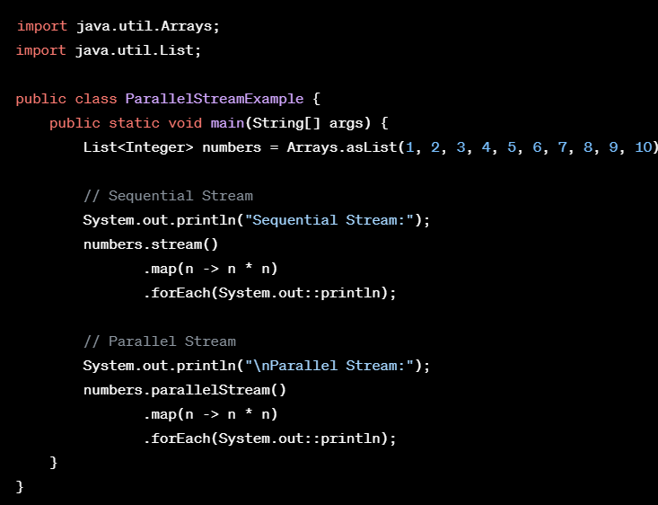

Slide 101
Sequential Stream:
In the sequential stream, the operations are performed sequentially on a single thread.
Each number is squared one after the other.
Parallel Stream:
In the parallel stream, Java automatically distributes the work across multiple threads.
This can lead to faster processing, especially when dealing with large datasets or computationally intensive operations.

Slide 102
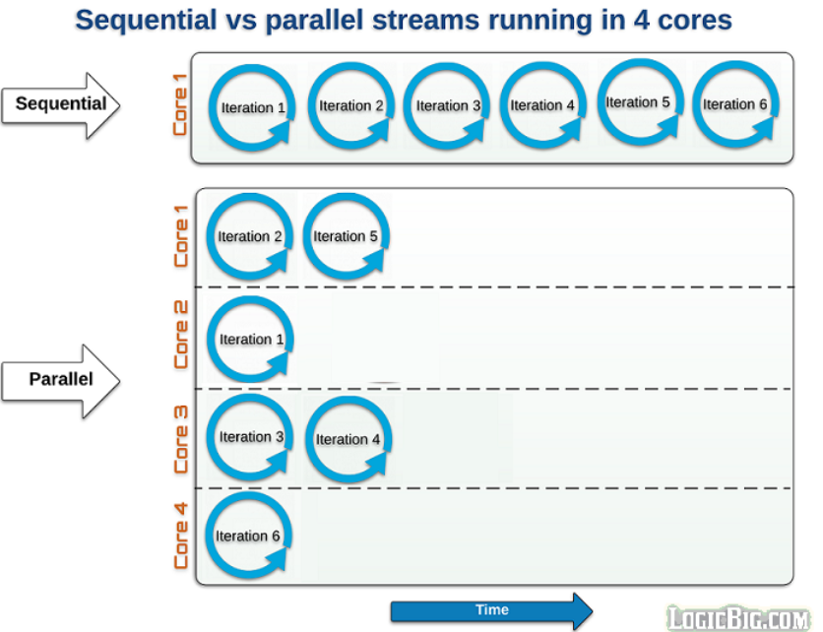

Slide 103
Key Takeaways:
Parallel streams allow concurrent processing and can improve performance for certain operations, especially with large datasets.
However, not all operations benefit from parallelization, and there may be overhead associated with managing multiple threads.
Always consider the nature of your tasks and benchmark your code to determine if using parallel streams provides a performance benefit for your specific use case.

Slide 104
CompletableFuture for asynchronous programming

Slide 105
Agenda
What is CompletableFuture?
Why CompletableFuture ?
How to create CompletableFuture
How to use runAsync and supplyAsyn method with usecase

Slide 106
What is CompletableFuture ?
Using Asynchronous programming you can write non blocking code where concurrently you can run N no of tasks in separate thread without blocking main thread.
When the task is complete, it notifies to the main thread (whether the task was completed or failed).

Slide 107
Why CompletableFuture ?
There are different ways to implement asynchronous programming in Java using any of the below mechanisms for example you can use Futures, ExecutorService, Callback interfaces,Thread Pools, etc.
It cannot be manually completed
Multiple Futures cannot be chained together
We cannot combine multiple Futures together
No Proper Exception Handling Mechanism

Slide 108
How to use runAsync and supplyAsyn method with usecase
runAsync()
If we want to run some background task asynchronously and do not want to return anything from that task, then use CompletableFuture.runAsync() method.
It takes a Runnable object and returns CompletableFuture<Void>.
CompletableFuture.runAsync(Runnable) -> ForkJoinPool.commonpool
CompletableFuture.runAsync(Runnable, Executor) -> executor Pool-thread

Slide 109
supplyAsyn()
If we want to run some background task asynchronously and want to return anything from that task, we should use CompletableFuture.supplyAsync().
It takes a Supplier<T> and returns CompletableFuture<T> where T is the type of the value obtained by calling the given supplier.
CompletableFuture. supplyAsync(Supplier<T>) -> ForkJoinPool.commonpool
CompletableFuture. supplyAsync(Supplier<T>,Executor) -> executor Pool-thread

Slide 110
Transforming and acting on a CompletableFuture
thenApply()
You can use thenApply() method to process and transform the result of a CompletableFuture when it arrives.
It takes a Function<T,R> as an argument. Function<T,R> is a simple functional interface representing a function that accepts an argument of type T and produces a result of type R -

Slide 111
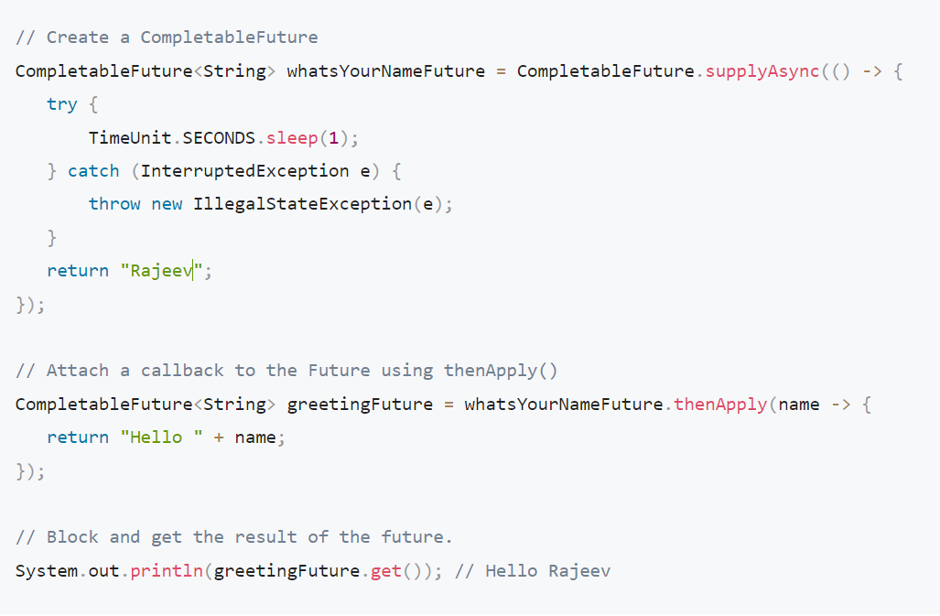

Slide 112
You can also write a sequence of transformations on the CompletableFuture by attaching a series of thenApply() callback methods.
The result of one thenApply() method is passed to the next in the series -

Slide 113
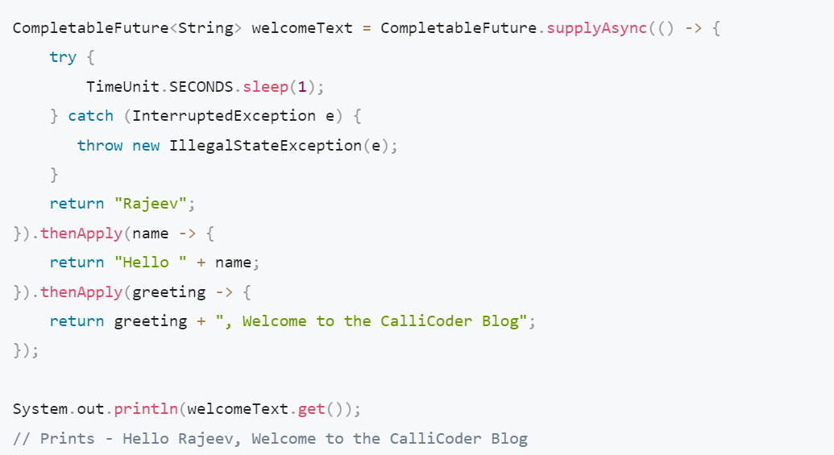

Slide 114
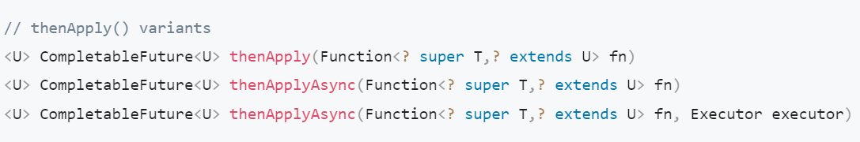
A note about async callback methods :
All the callback methods provided by CompletableFuture have two async variants -

Slide 115
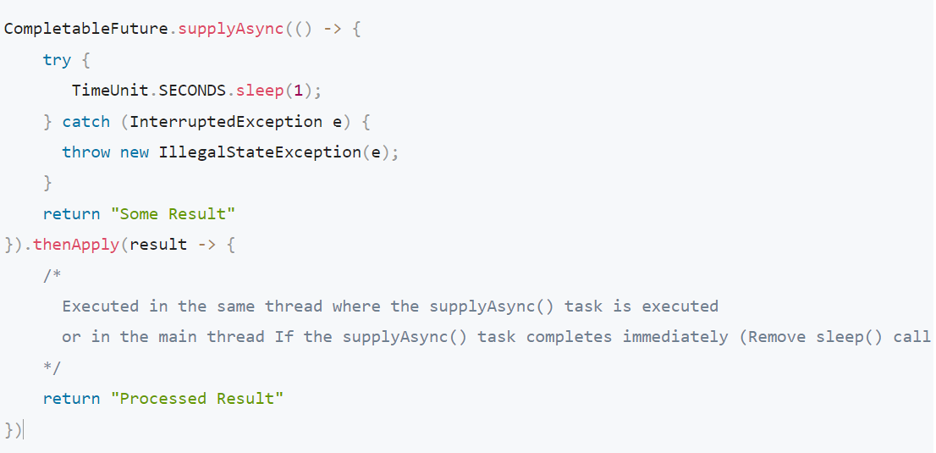

Slide 116
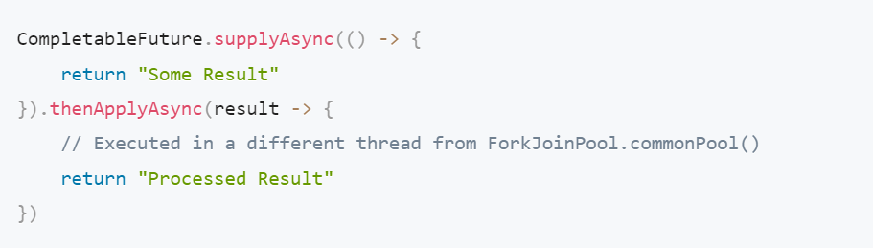

Slide 117
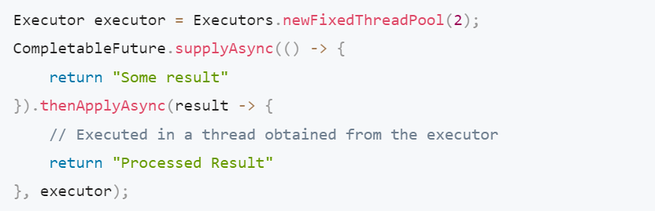

Slide 118
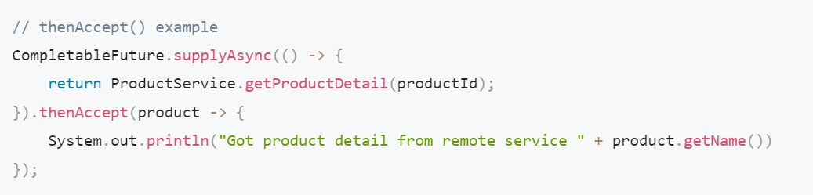
thenAccept() and thenRun()
If you don’t want to return anything from your callback function and just want to run some piece of code after the completion of the Future, then you can use thenAccept() and thenRun() methods.

Slide 119
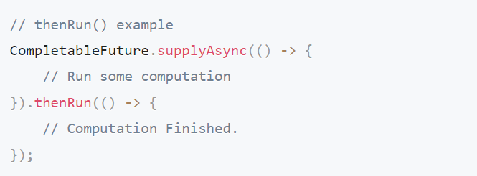

Slide 120
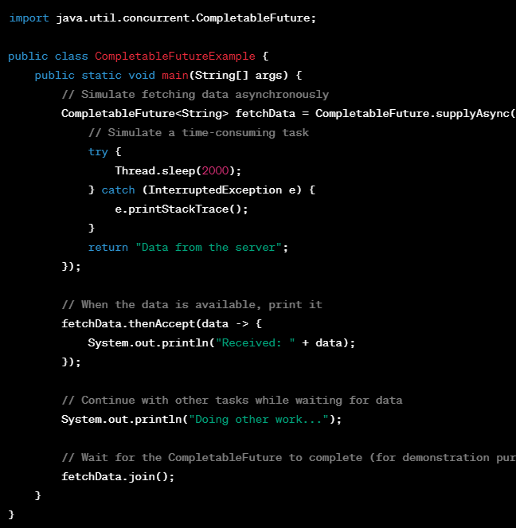
join(): the method returns the result value when complete.
It also throws a CompletionException (unchecked exception) if completed exceptionally.

Slide 121
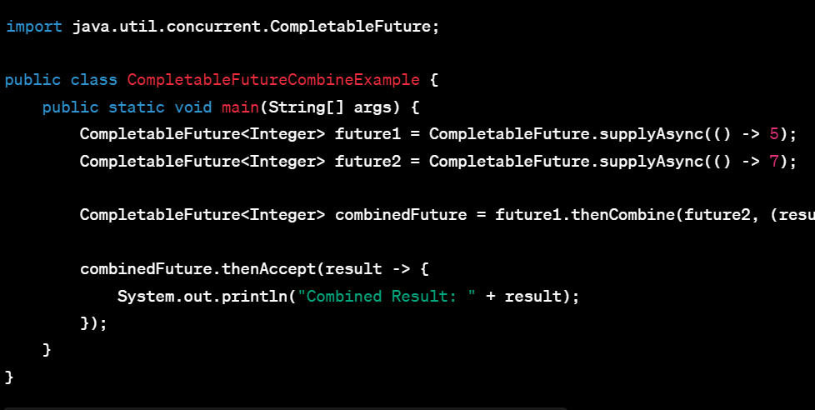
thenCombine () : It combine results from multiple asynchronous tasks.

Slide 122
thenCompose() :
thenCompose() method is used in CompletableFuture.
when we have two dependent asynchronous tasks, and the result of the first task determines the second task.
The second task is expressed as a function that takes the result of the first task and returns a new CompletableFuture.

Slide 123
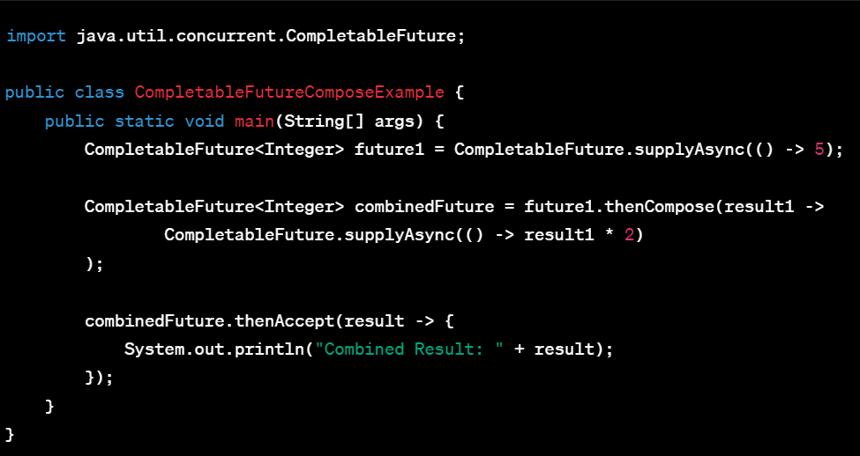

Slide 124
allOf() :
The CompletableFuture.allOf() method in Java is used to create a new CompletableFuture
That completes only when all the given CompletableFutures in a collection have completed, allowing for coordinated handling of multiple asynchronous tasks.

Slide 125
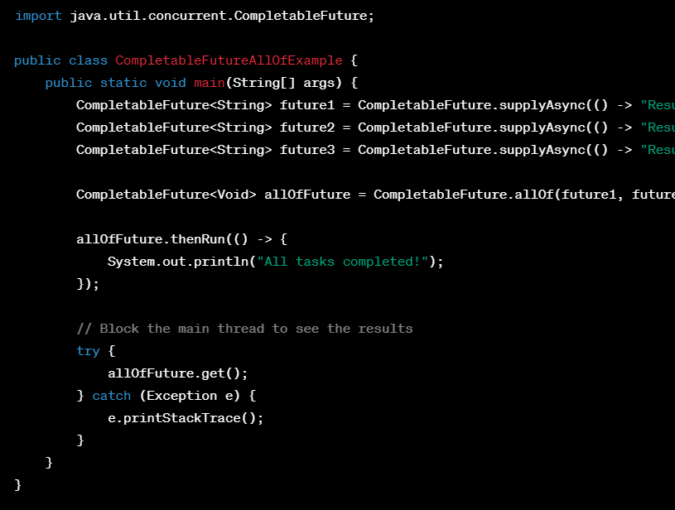

Slide 126
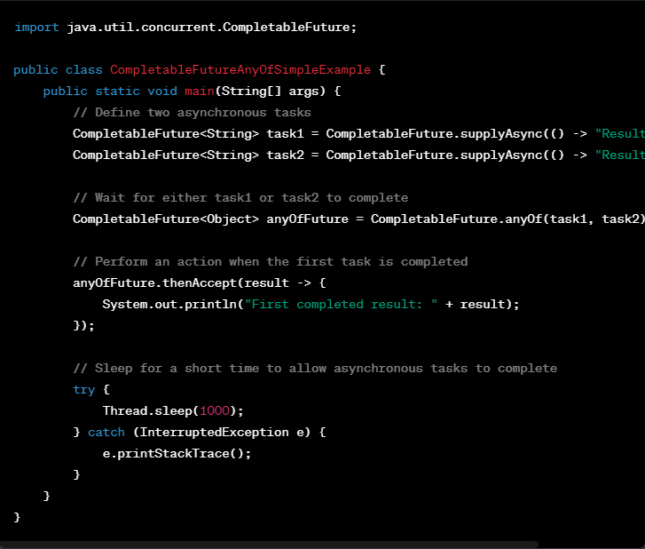
anyOf() :
returns a new CompletableFuture which is completed when any of the given CompletableFutures complete, with the same result.

Slide 127
Handling exceptions in CompletableFutures
Handling exceptions in CompletableFutures can be done using methods like exceptionally or handle
exceptionally()
We can handle exceptions in CompletableFutures by providing a fallback value when an exception occurs during task execution.
Handle()
The handle method in CompletableFutures allows you to handle both the result and exceptions, offering flexibility in recovery or processing."

Slide 128
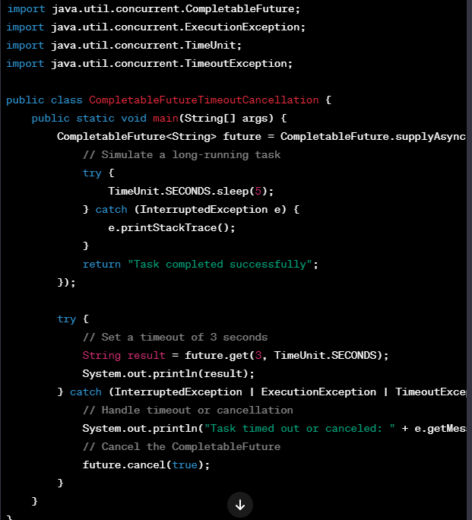
CompletableFuture timeouts and cancellation :
We can set timeouts to limit the maximum duration of a task, and if the task exceeds the specified time, it can be cancelled."

Slide 129
Day 9

Slide 130
Thread Safety Techniques
Immutable objects
Thread-local storage
Concurrency control using locks
Atomic variables and classes
Concurrent collections (ConcurrentHashMap, ConcurrentLinkedQueue, etc.)
Software Transactional Memory (STM)

Slide 131
Immutable objects:
Immutable objects are objects whose state cannot be modified after creation, ensuring that their values remain constant throughout their lifetime.
Thread-local storage :
Thread-local storage allows variables to have separate values for each thread, ensuring that each thread works with its own isolated data.

Slide 132
Concurrency control using locks :
Concurrency control using locks is like having a key for shared resources, allowing one thread at a time to access and modify the resource, preventing clashes between multiple threads.
Atomic variables and classes :
Atomic variables and classes in Java, found in the java.util.concurrent.atomic package, provide thread-safe operations without the need for explicit locking.
They're used to ensure that certain operations are executed atomically, without interference from other threads.

Slide 133
Concurrent collections :
Concurrent collections like ConcurrentHashMap and ConcurrentLinkedQueue are designed for safe and efficient concurrent access by multiple threads, ensuring data consistency without the need for explicit synchronization.
Software Transactional Memory (STM) :
Software Transactional Memory (STM) simplifies concurrent programming by allowing multiple operations to be treated as a single, atomic transaction, ensuring consistency in shared data without explicit locks.

Slide 134
Thank you all……

